Slide 1
Project Review
ME100
Team 100

Slide 2
Project Materials
ESP32 × 3
• One for turret sensors (ultrasonic,)
• One for base motor + laser control
• One for light-check (photoresistor) and button trigger logic
DRV8833 Motor Driver
12V DC Motor w/ Encoder
RCWL-1601 UDS (Ultrasonic Distance Sensor)
Photoresistor (LDR GM5539)
Laser Pointer (5mW, 650nm)
Button
5V Power Supply

Slide 3
Component Functionality
ESP32 (Sensor Unit)
Reads distance from ultrasonic sensor
Monitors ambient light with photoresistor
Sends event triggers to base ESP via ESP-NOW
ESP32 (Base Controller)
Drives the motor for turret rotation
Controls the servo aiming the laser
Handles movement logic based on sensor triggers
ESP32 (Trigger Node)
Reads button press
Only enables toy operation if photoresistor detects low ambient light
Acts as a safety and context-aware activation node
DRV8833 Motor Driver
Bridges control signals from ESP32 to the DC motor
Allows directional PWM control for smooth laser motion

Slide 4
Component Functionality
12V DC Motor w/ Encoder
Drives turret rotation with closed-loop feedback
Encoder allows precise positioning and randomized redirection
RCWL-1601 UDS (Ultrasonic Sensor)
Detects when the cat paw approaches
2–450 cm range with ~50ms measurement period
Laser Pointer
Bright, low-power (5mW) red laser (650nm) for cat engagement
Mounted on servo for directional redirection
Photoresistor (LDR GM5539)
Detects ambient lighting conditions
Prevents toy from activating during bright daylight
Enables play only in dim lighting (e.g., evening)
Momentary Button
Manual activation switch for the entire system
Works in combination with the photoresistor to trigger the play state

Slide 5
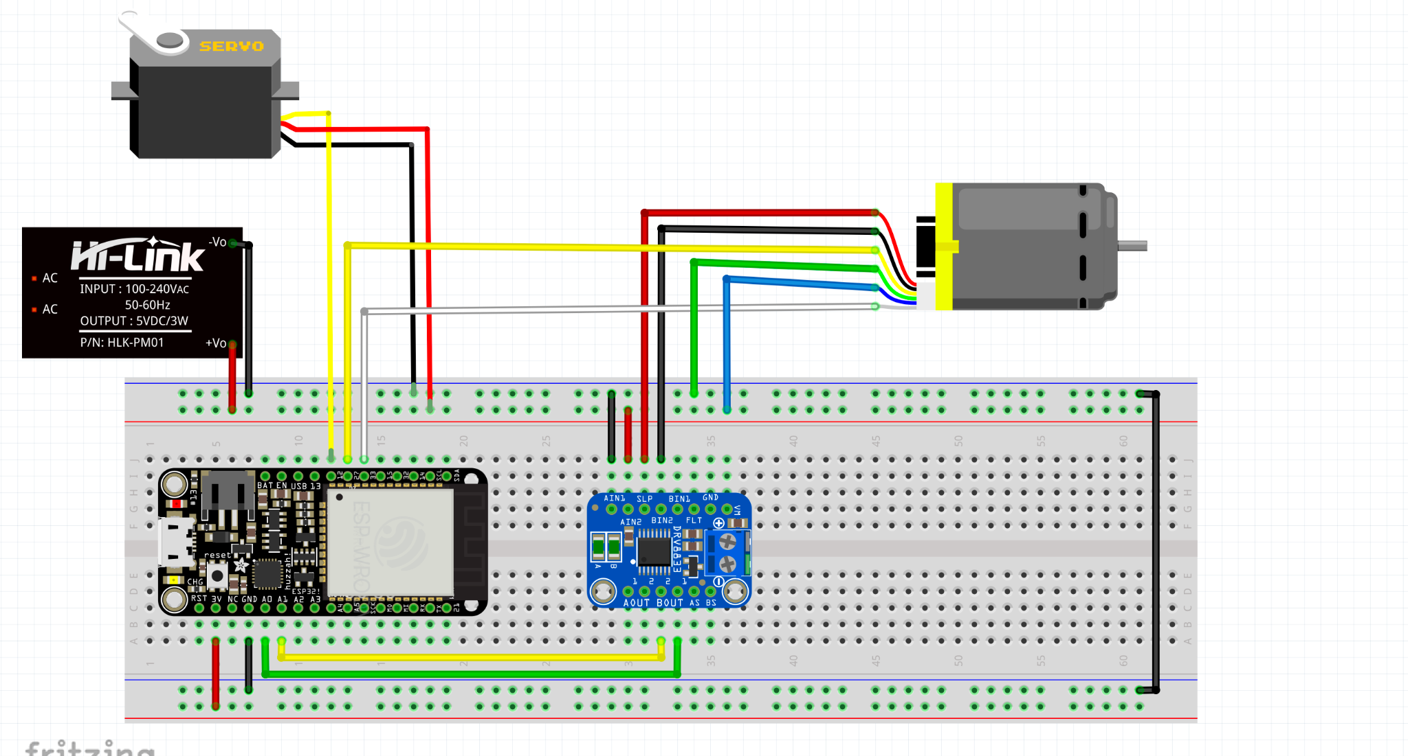
WIRING LAYOUT - BASE

Slide 6
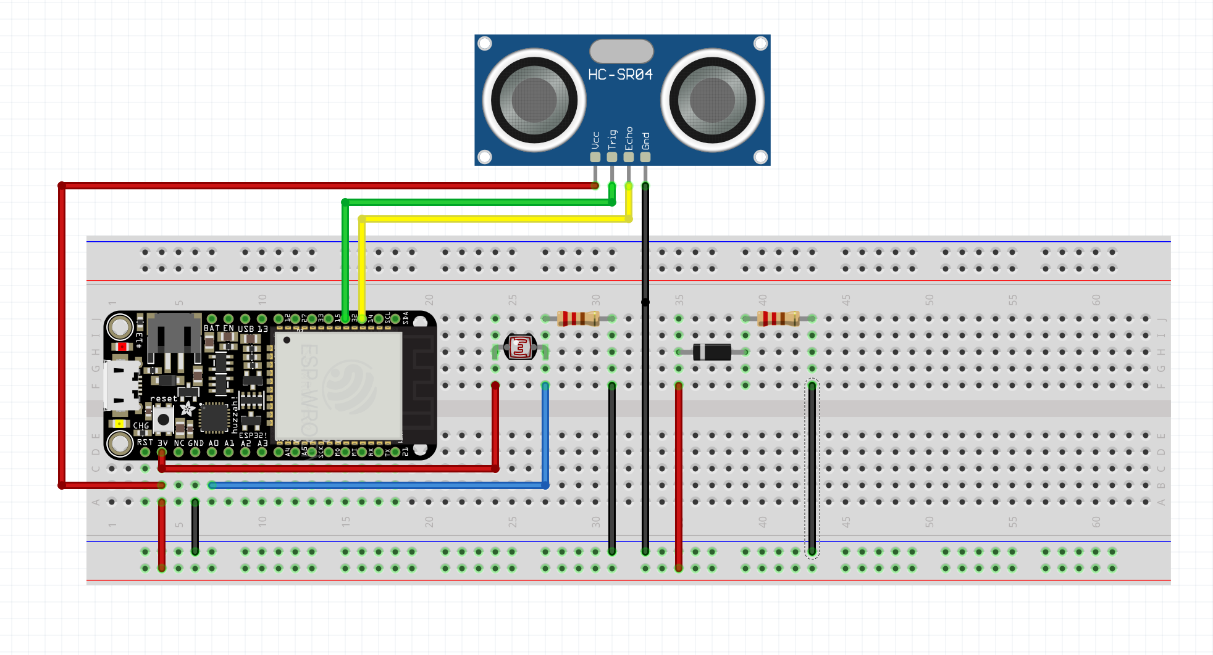
WIRING LAYOUT - SENSOR

Slide 7
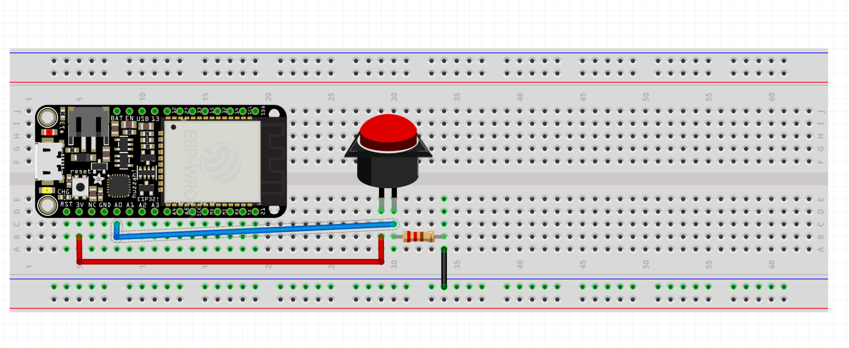
WIRING LAYOUT - TRIGGER

Slide 8
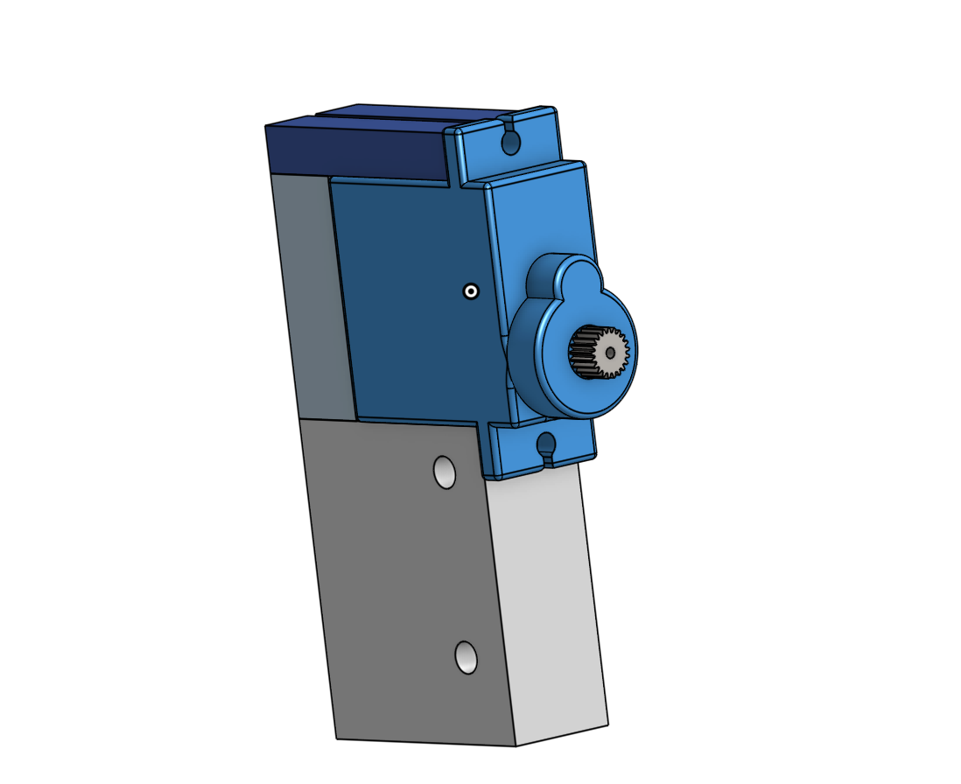
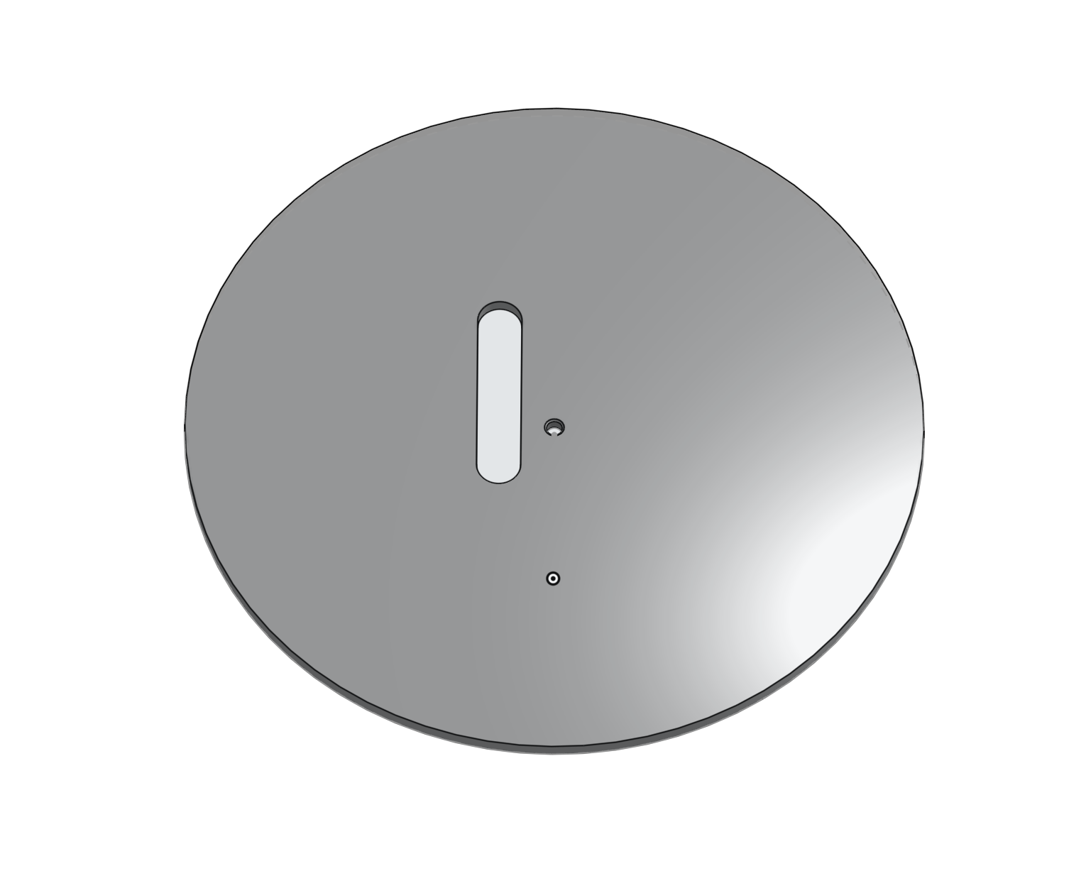
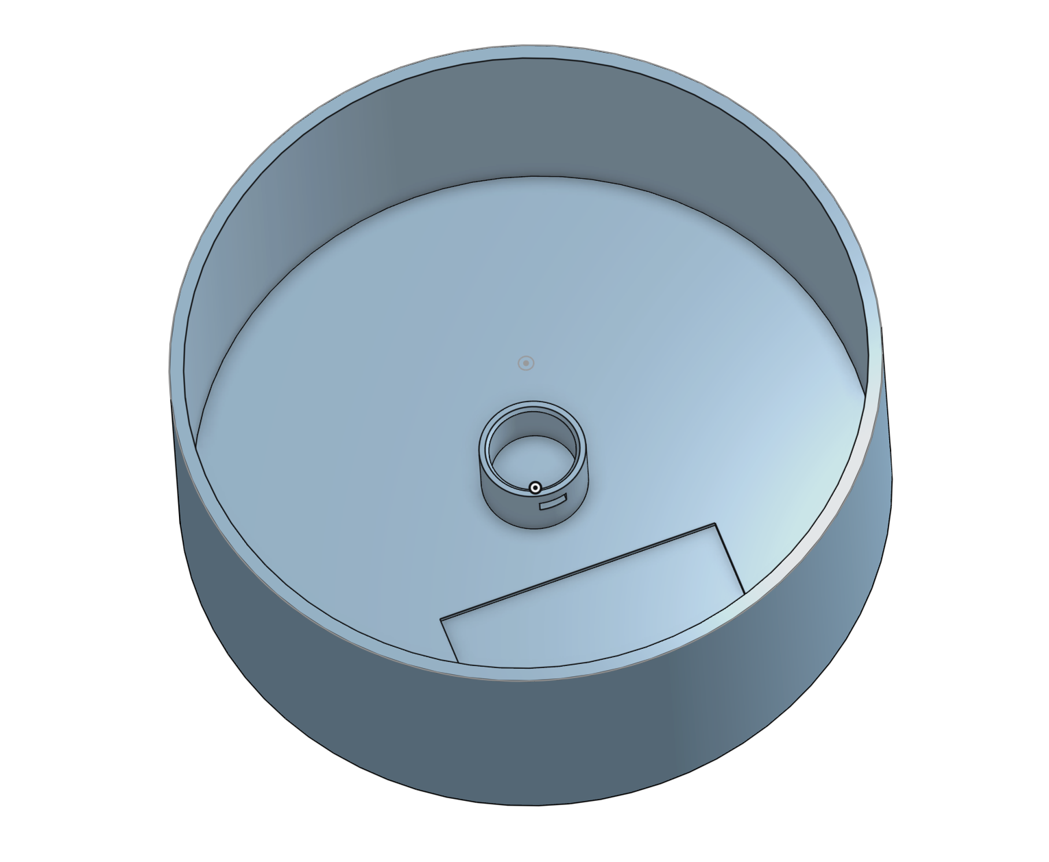
RELEVANT CAD
Servo + Ultrasonic Mount
Cat Toy Base
Cat Toy Lid

Slide 9
IOT CONNECTION
ESP32 modules communicate using ESP-NOW:
The Sensor ESP32 sends paw detection events to the Base ESP32, which executes laser and motor actions
The Trigger ESP32 sends a wake signal to the others only if the photoresistor detects low light and the button is pressed

Slide 10
RELEVANT CODE
All relevant code included in : CODE INFO

